Slide 1


Reduced order heat transfer model to simulate the battery cell thermal runaway propagation within a module
Jinghu hu
PhD Candidate, The University of Texas at Austin

Slide 2
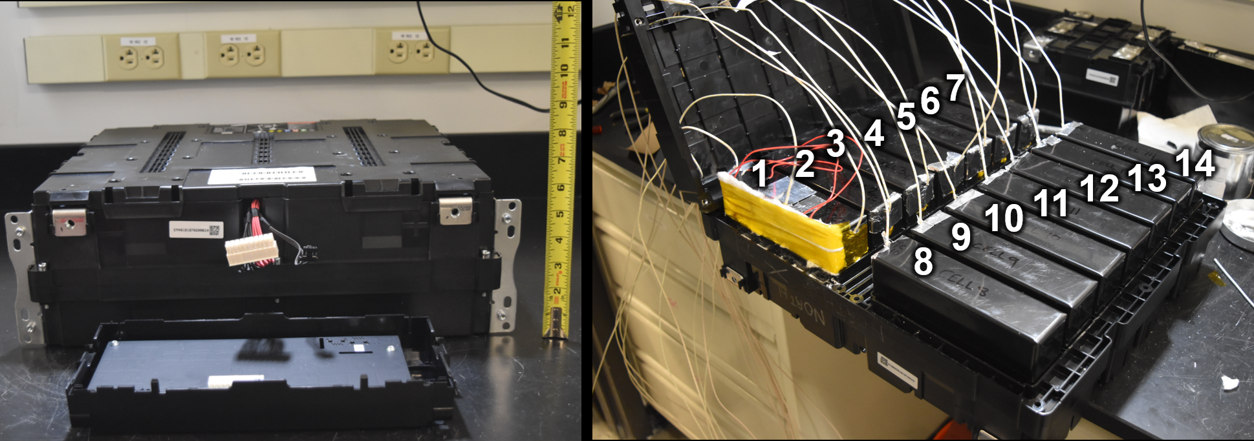
Prismatic cell module TR propagation modeling
Previously the battery cell thermal failure and the propagation of thermal runaway experiment has been carried out and relevant data has been collected
A reduced-order heat transfer model, focusing on the radiation, convection, conduction and enthalpy exchange between cells and surrounding air, could play an important role in simulating the cell-to-cell thermal runaway propagations

Slide 3
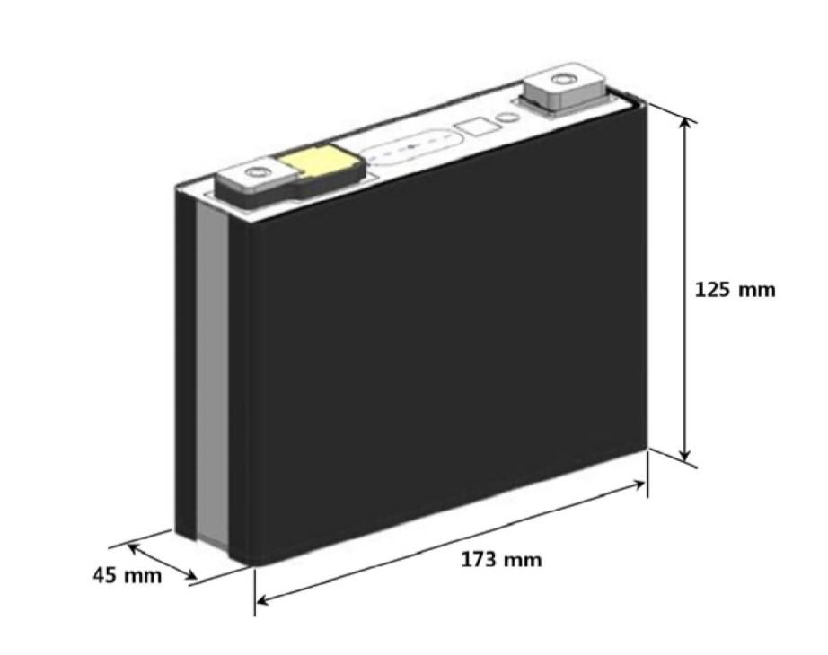
Prismatic cell module TR propagation modeling: experiments
air block
Cell
(1, 1)
Cell
(1, 2)
Cell
(1, n)
L2
…
L1
Cell
(2, 1)
…
Each cell has nominal average capacity of 95.6 Ah
14 cells connected in series in a module compartment

Slide 4
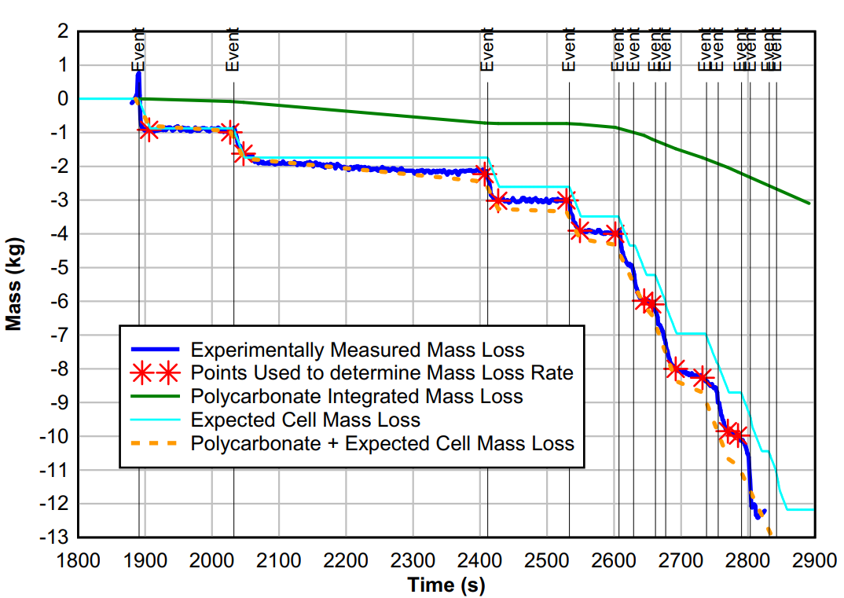
The experimental data to be compared with

Slide 5
Prismatic cell module TR propagation modeling: models
each cell was treated as lumped, and the air block surrounding the cell considered as a whole; a cell would go to TR once the cell lumped temperature reached a certain temperature threshold Tign
The model simplified TR propagation processes simulation to a zero-dimension heat transfer simulation. If all heat transfer rates were calculated, the cell/air temperature profiles could be known;TR propagation profile would be computed
Multiple heat transfer means were considered:
radiation (cell to adjacent cells, cell to air)
convection (cell to air)
conduction (cell-to-cell)
energy loss due to mass loss
heat release from thermal runaway (TR)
TR-caused local compartment fire and consequential heat sources to the cell (added 02/16/2023)
Heat transfers via base and/or electrical connection tab from cell 1 to cell 2 (added 02/16/2023, all other inter-cell heat transfer via bases/tabs currently not considered)
air block
…
…
…

Slide 6
Detailed assumptions
air block
The manually failed cell at the top left corner was modeled to have a constant heating source until TR took place
For now we assumed 20% of the external heating power went into cell 2 due to electrical connection & base
The pre-TR gas venting was ignored for the current model
Heat release from exothermic chemical reactions was assumed to be strictly accompanied by the gas venting process; both assumed to be start right at the start of TR and end some time later at the same time
Whenever a cell went into thermal runaway, we assumed that there is a local additional heating source (from compartment fire) lasting for 20 seconds with heating power 5200 W exerting onto the adjacent cells
…
…
…

Slide 7
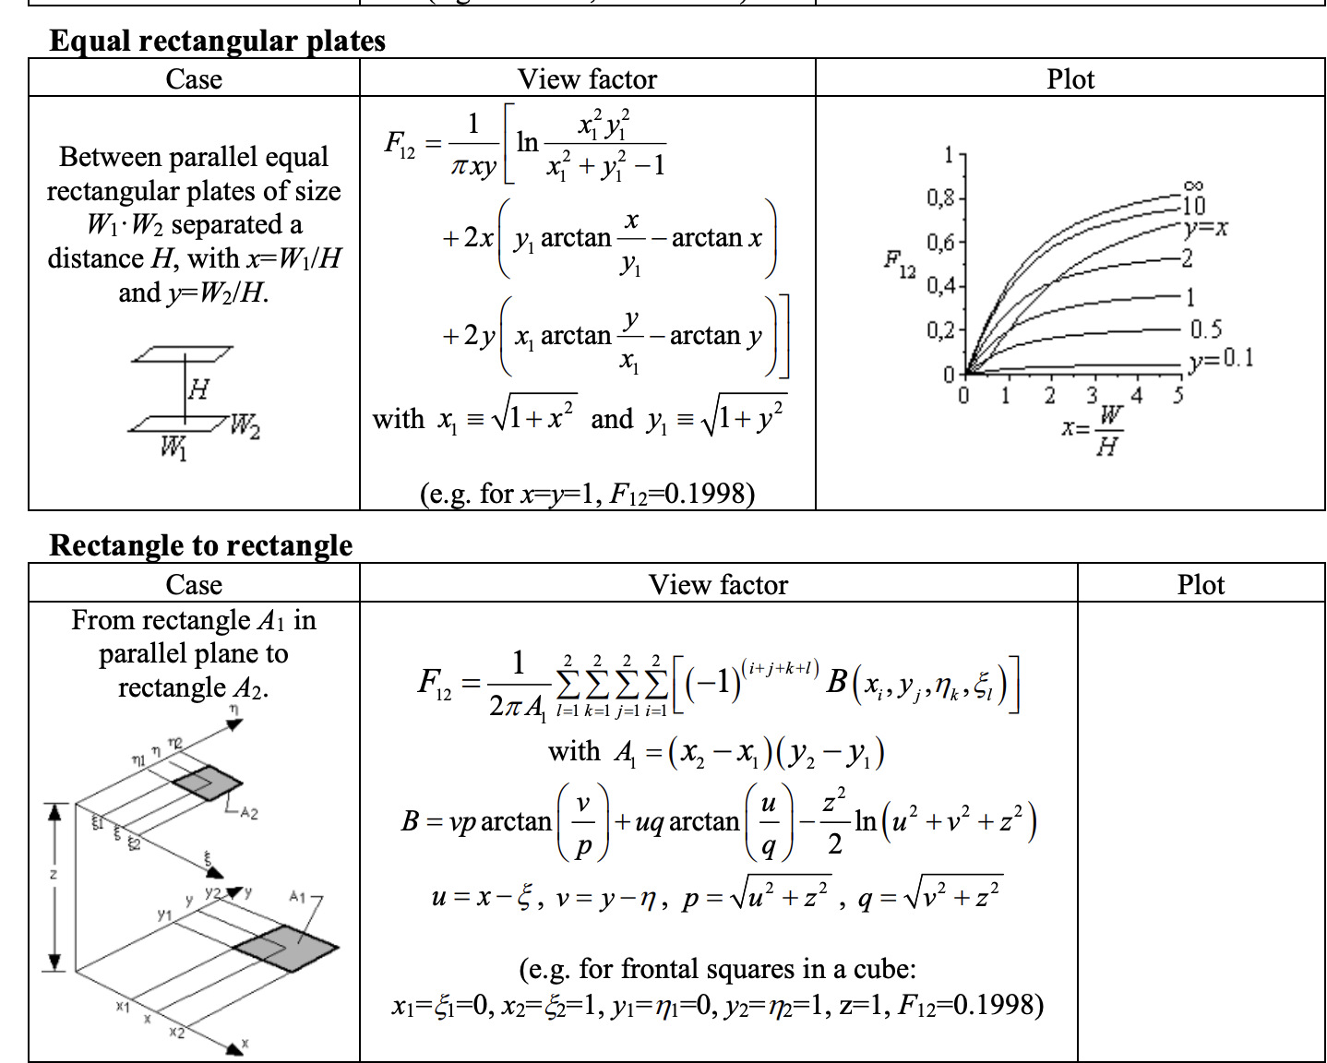
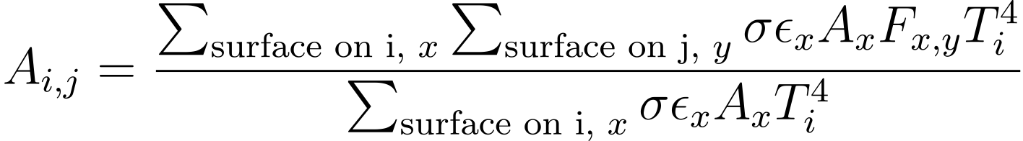
Radiation modeling
A radiation energy transfer matrix A, was calculated: A is a 15x15 matrix in which element Aij represented the proportion of radiated energy rate absorbed by cell j over the total radiation heat release rate from cell i
For battery cells, a certain cell could only “see” the adjacent cells and the air block in terms of radiation. Each Aij was calculated after calculating the radiation area and the view factors
air block
…
…
View Factor calculations: Martinez, I. Radiation View Factors
http://webserver.dmt.upm.es/~isidoro/tc3/Radiation%20View%20factors.pdf

Slide 8
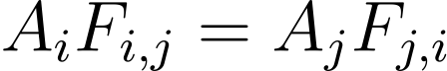
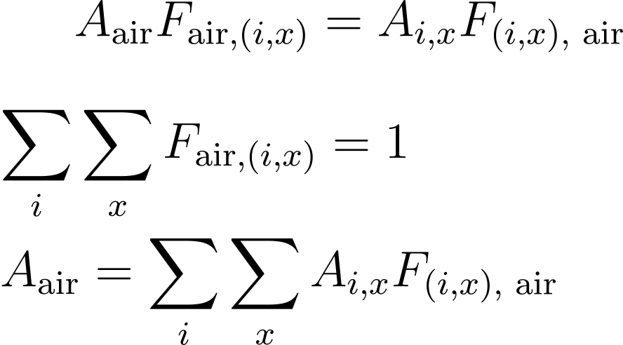
Radiation modeling
For air block, we assumed that the view factors towards every cell were the same:
We then calculated the air “equivalent” radiation area using the rule of reciprocity
air block
…
…
View Factor calculations: Martinez, I. Radiation View Factors
http://webserver.dmt.upm.es/~isidoro/tc3/Radiation%20View%20factors.pdf

Slide 9
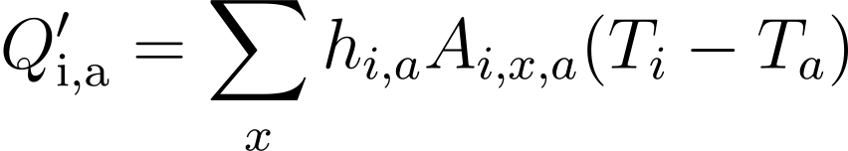
Convection modeling
For convection, we assumed a simple format of Newton law of cooling
The overall convection heat transfer between a certain cell and the air block was calculated to be the product of a pre-determined convection heat transfer coefficient, total area of heat transfer of the cell, and the temperature difference between the cell and the air:
…

Slide 10
Potential Conductions: due to the volume expansion
Cell expansion due to gas production took place before/during TR
Such expansions led to cells being in direct contact with each other, significantly increasing the magnitude of heat transfers
Currently, a processing method would be:
In the width direction, if none of the two adjacent cells went into thermal runaway, then the cell-to-cell conduction was not considered
If one of the two adjacent cells failed, the cell-to-cell distance was reduced to half (1.5 cm) and the thermal conduction was considered
If both failed, the cell-to-cell distance was assumed to be 1mm and the thermal conduction was considered
The air thermal conductivity was a function of air temperature
air block
…
…

Slide 11
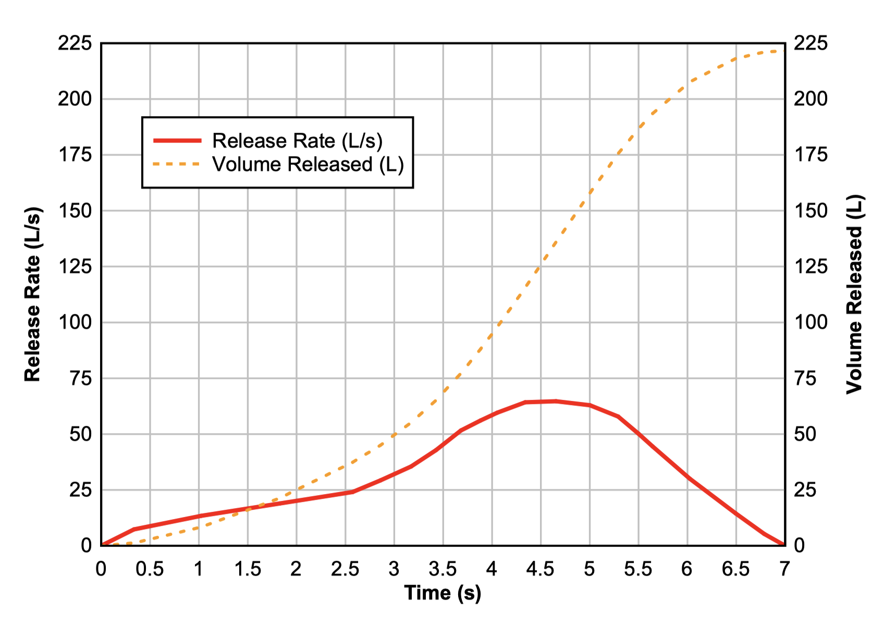
Energy transfer due to mass transfer: enthalpy
During TR, certain amount of gas and solid particles were vented from the cell
The total mass loss from thermal runaway was known from experiments (~1kg/cell) and the whole mass loss process was assumed to take place within 7 seconds
The volumetric loss rate from gas was obtained from experiments; the mass loss rate from gas was calculated from measured volumetric gas venting rate; the mass loss rate from particles was then calculated
…
Graphs : Archibald, E. Fire & explosion hazards due to thermal runaway propagation in lithium-ion battery systems
https://repositories.lib.utexas.edu/handle/2152/86761

Slide 12
Energy transfer due to mass transfer: enthalpy
The air block was assumed to have constant mass throughout the process: when certain amount of gas vented from into the air block, the same amount of air mass would leave the air block
It was assumed that both gas and solid particles will exchange heat with air instantaneously
the cell masses were included as state variables
…
Graphs : Archibald, E. Fire & explosion hazards due to thermal runaway propagation in lithium-ion battery systems
https://repositories.lib.utexas.edu/handle/2152/86761

Slide 13
Prismatic cell module TR propagation modeling: models
Summarizing all the assumptions and equations, the main equations were obtained:

Slide 14
The whole model in 1 page
Zero-dimension (lumped) model for battery cells; essentially a ODE system
Set a threshold temperature for cell, over which the cell(s) will go into thermal runaway (TR); reduced the TR propagation model to heat transfer model
Consider multiple heat transfer means; Several parameters obtained via experimental results

Slide 15
The heat transfer model
Considered multiple heat transfer means:
radiation (cell to adjacent cells, cell to air)
convection (cell to air)
conduction (cell-to-cell)
energy loss due to mass loss
heat release from thermal runaway (TR)
TR-caused local compartment fire and consequential heat sources to the cell (added 02/16/2023)
Heat transfers via base and/or electrical connection tab from cell 1 to cell 2 (added 02/16/2023, all other inter-cell heat transfer via bases/tabs currently not considered)

Slide 16
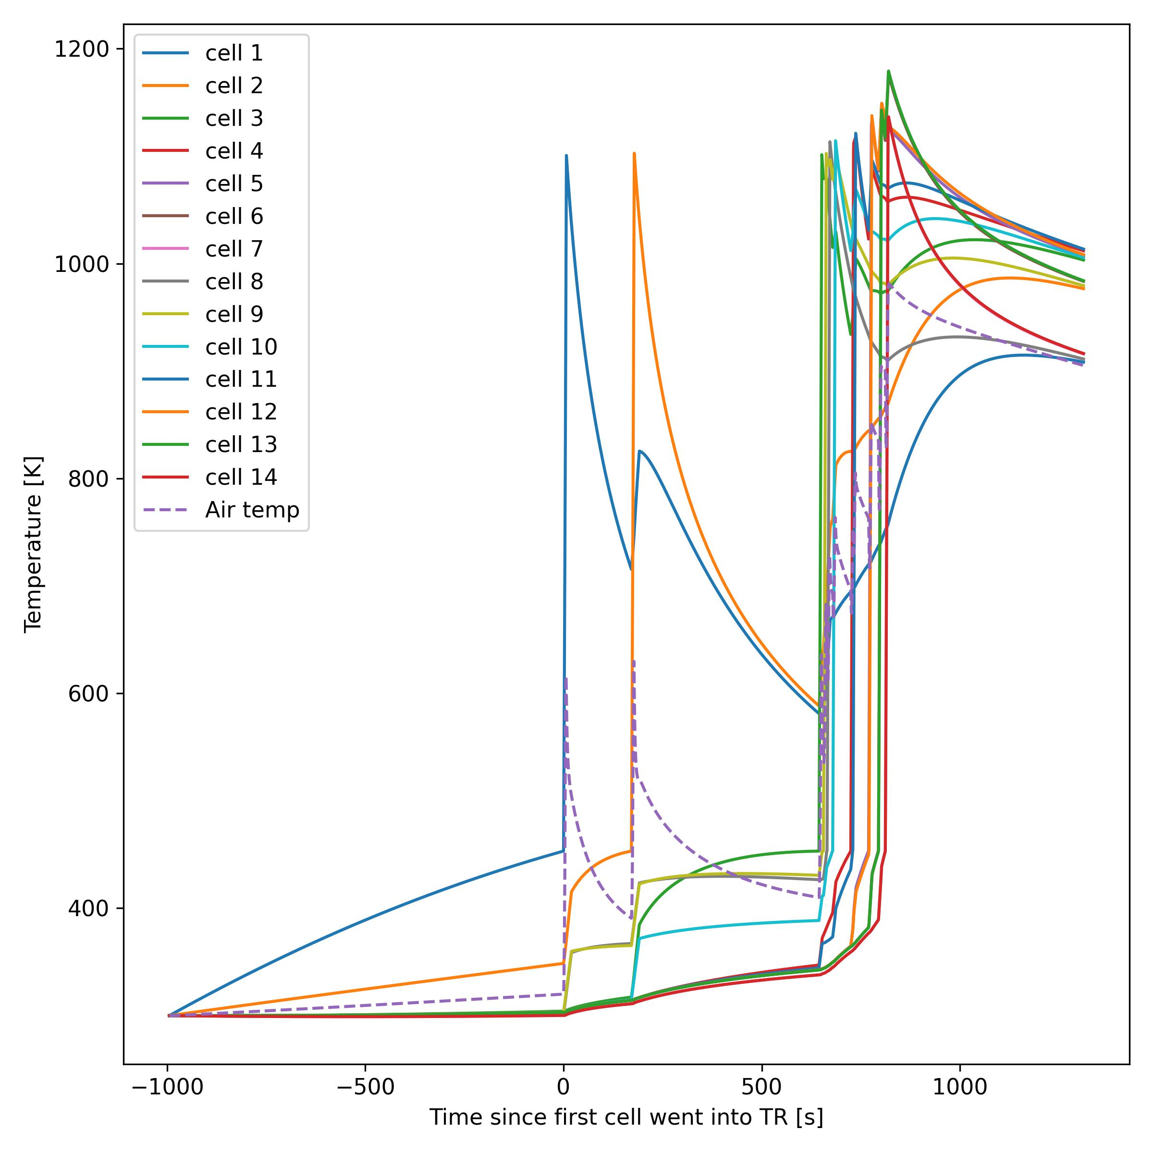
Preliminary Results
Starting from cell 3, the TR propagated in a much faster pattern
The TR propagated at first at the width pattern, then in a wave pattern
Cell index | Time to fail this cell (s)
1 | 994.5
2 | 171.2
3 | 473.2
9 | 11.2
8 | 9.2
10 | 14.2
4 | 45.7
11 | 5.2
5 | 39.7
12 | 1.2
6 | 23.7
13 | 0.2
14 | 17.2
7 | 0

Slide 17
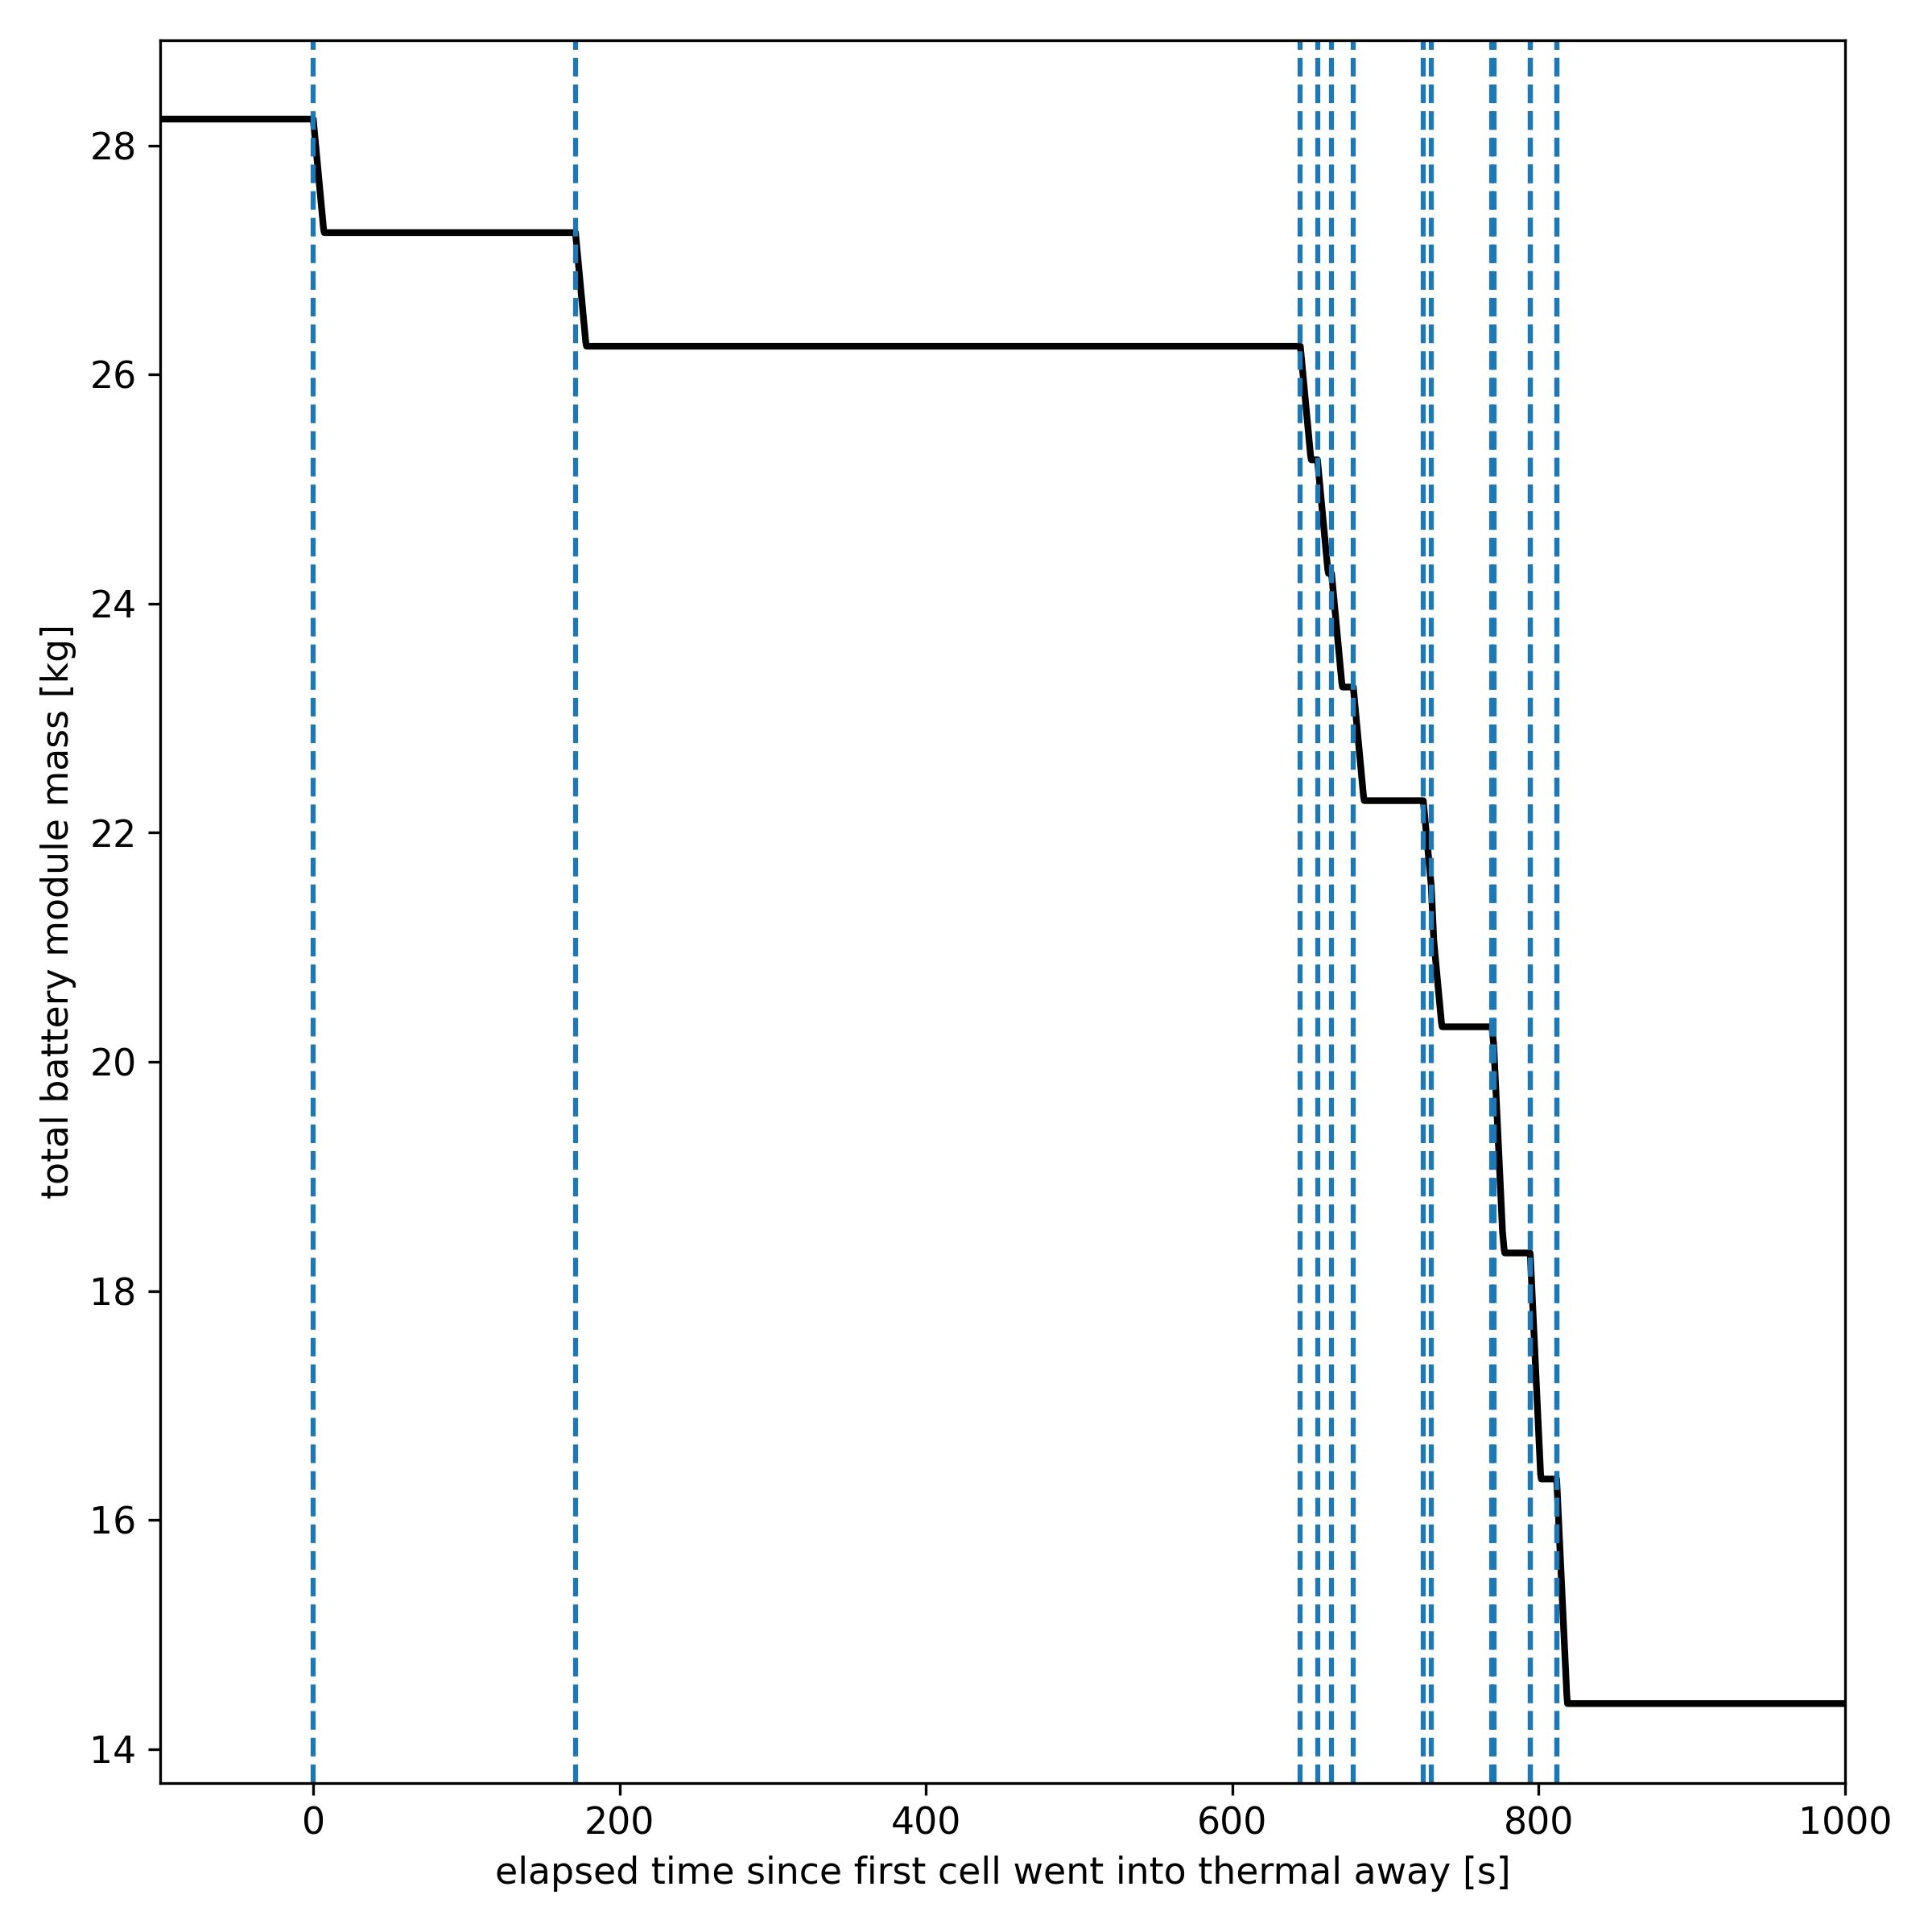
Preliminary Results

Slide 18
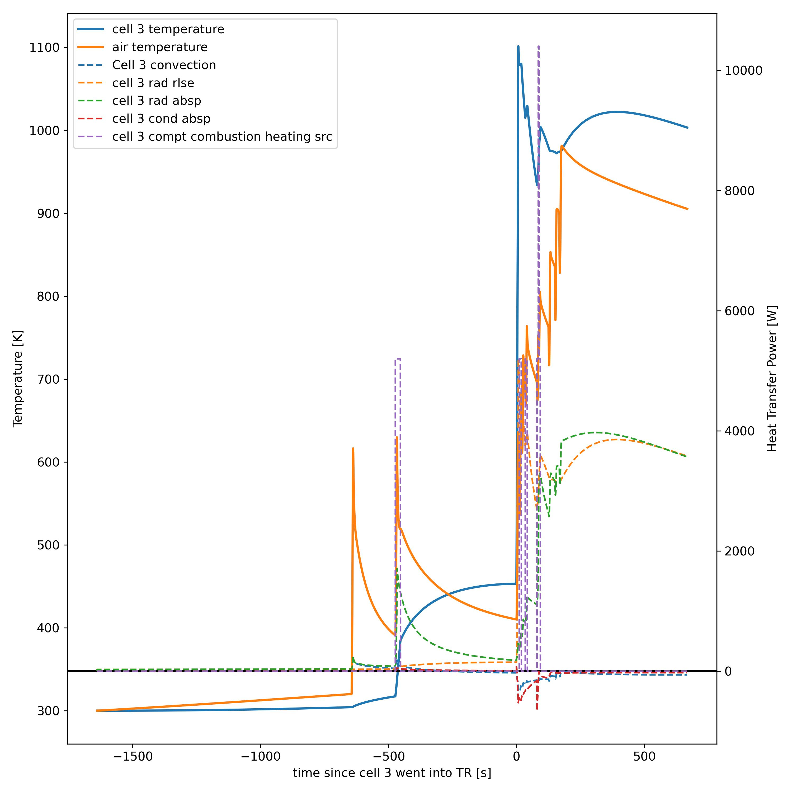
Preliminary Results
For cell 3, the cell 2 going into thermal runaway not only provided a 20 second local heating due to compartment fire, but also served as a long duration of radiation heating source. These two factors contributed to the thermal 3 going into thermal runaway.
Cell 3 power budget graph

Slide 19
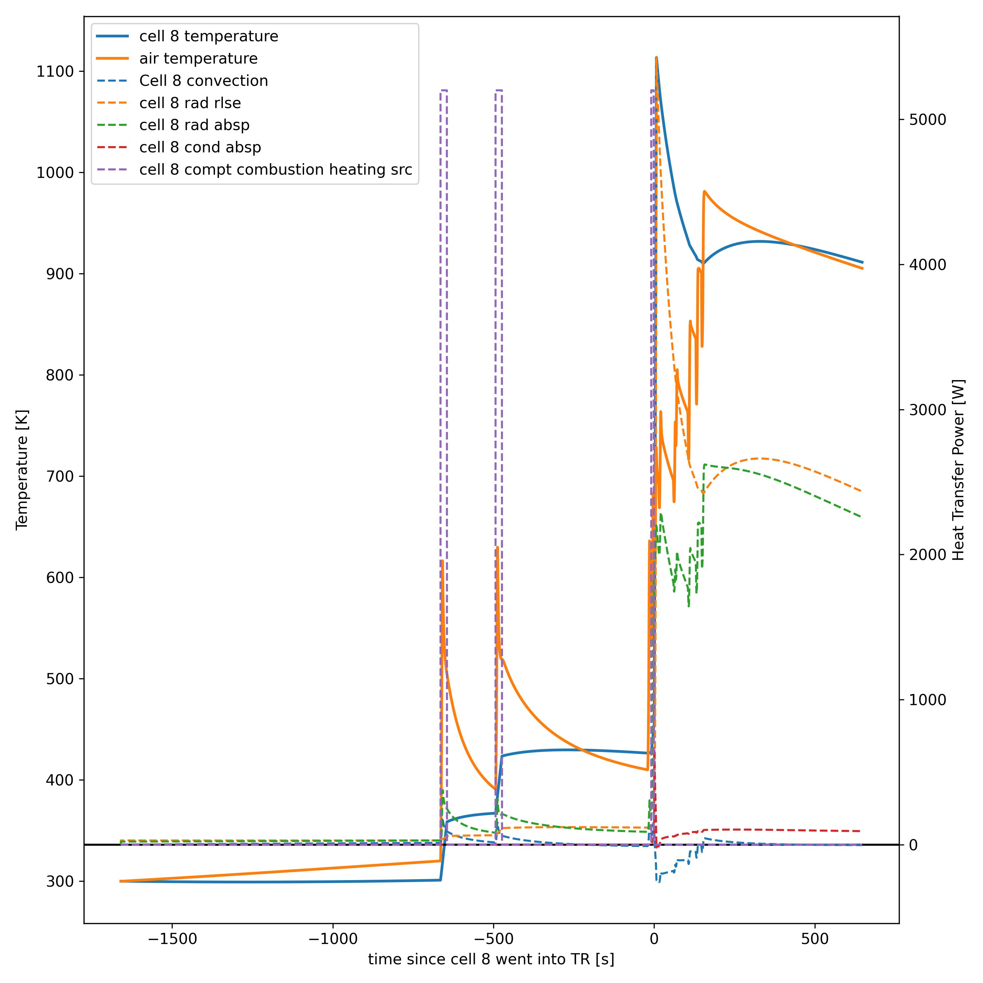
Preliminary Results
For cell 8, the compartment fire heating sources caused by adjacent cells TR was the main contributor of it reaching to the threshold temperature and going into thermal runaway.
The radiation contribution also played a role, but not too significantly
Cell 8 power budget graph

Slide 20
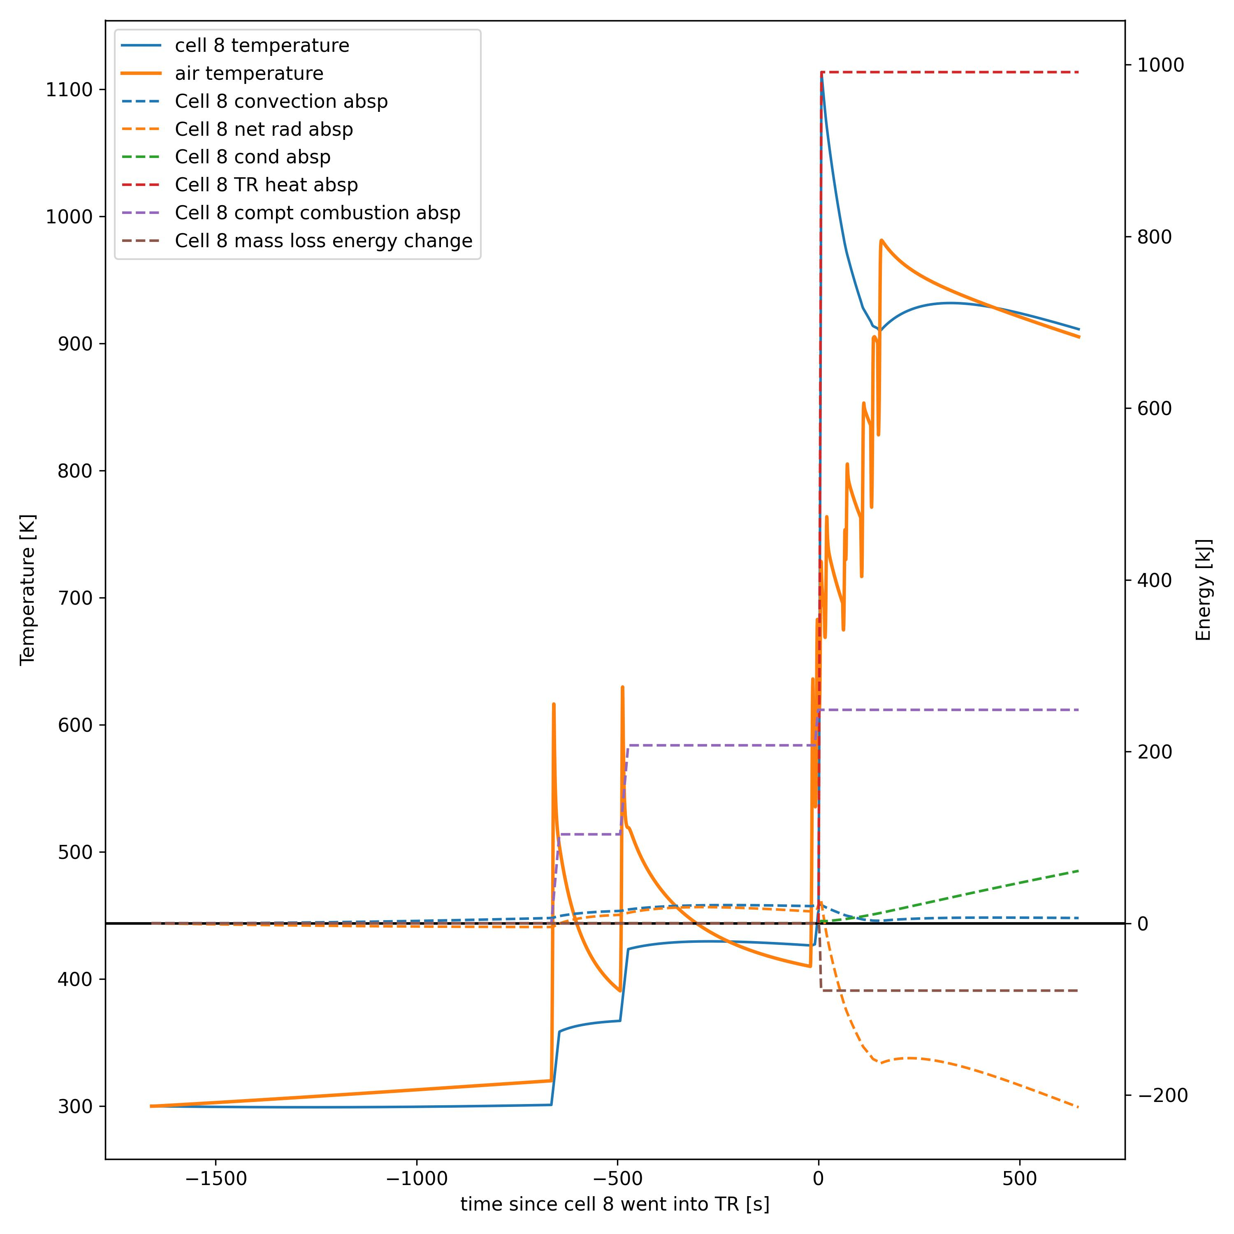
Preliminary Results
For cell 8, the compartment fire heating sources caused by adjacent cells TR was the main contributor of it reaching to the threshold temperature and going into thermal runaway.
The radiation and the convection contribution also played a role, but not too significantly
Cell 8 energy budget graph

Slide 21
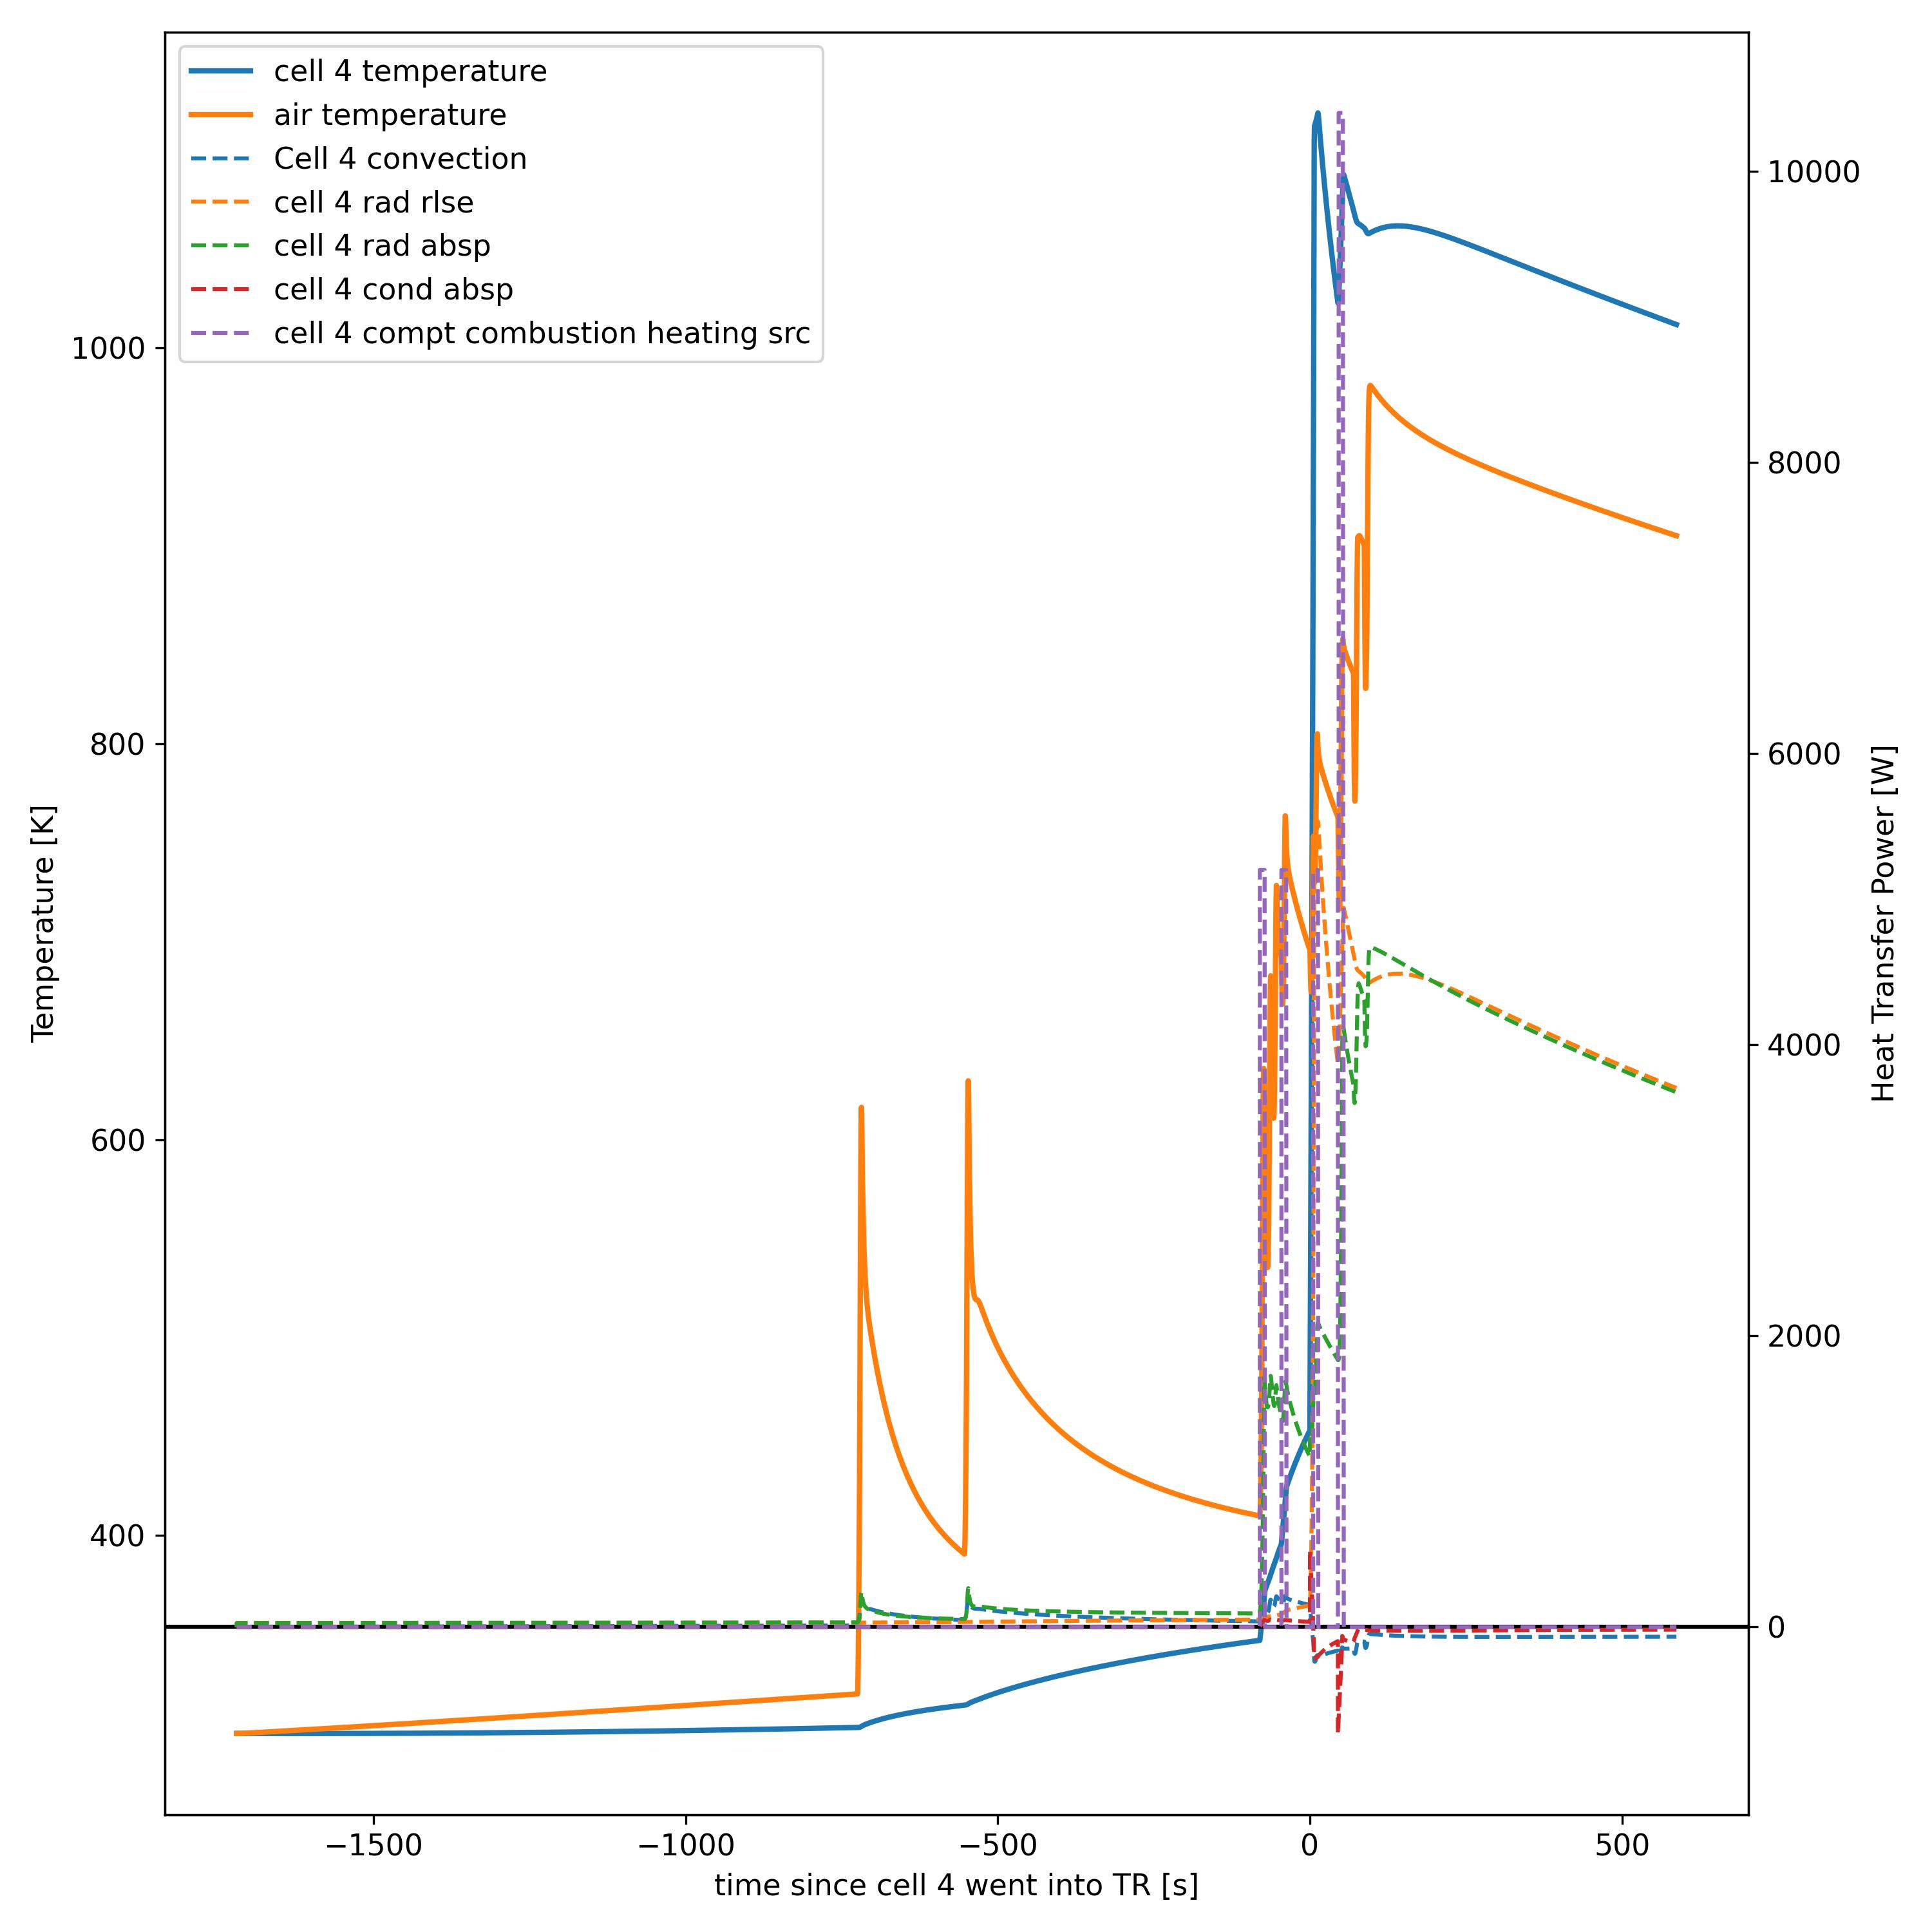
Preliminary Results
For cell 4, the compartment fire was also the main contributor of the fast temperature up climb and the sequential TR
Cell 4 power budget graph

Slide 22
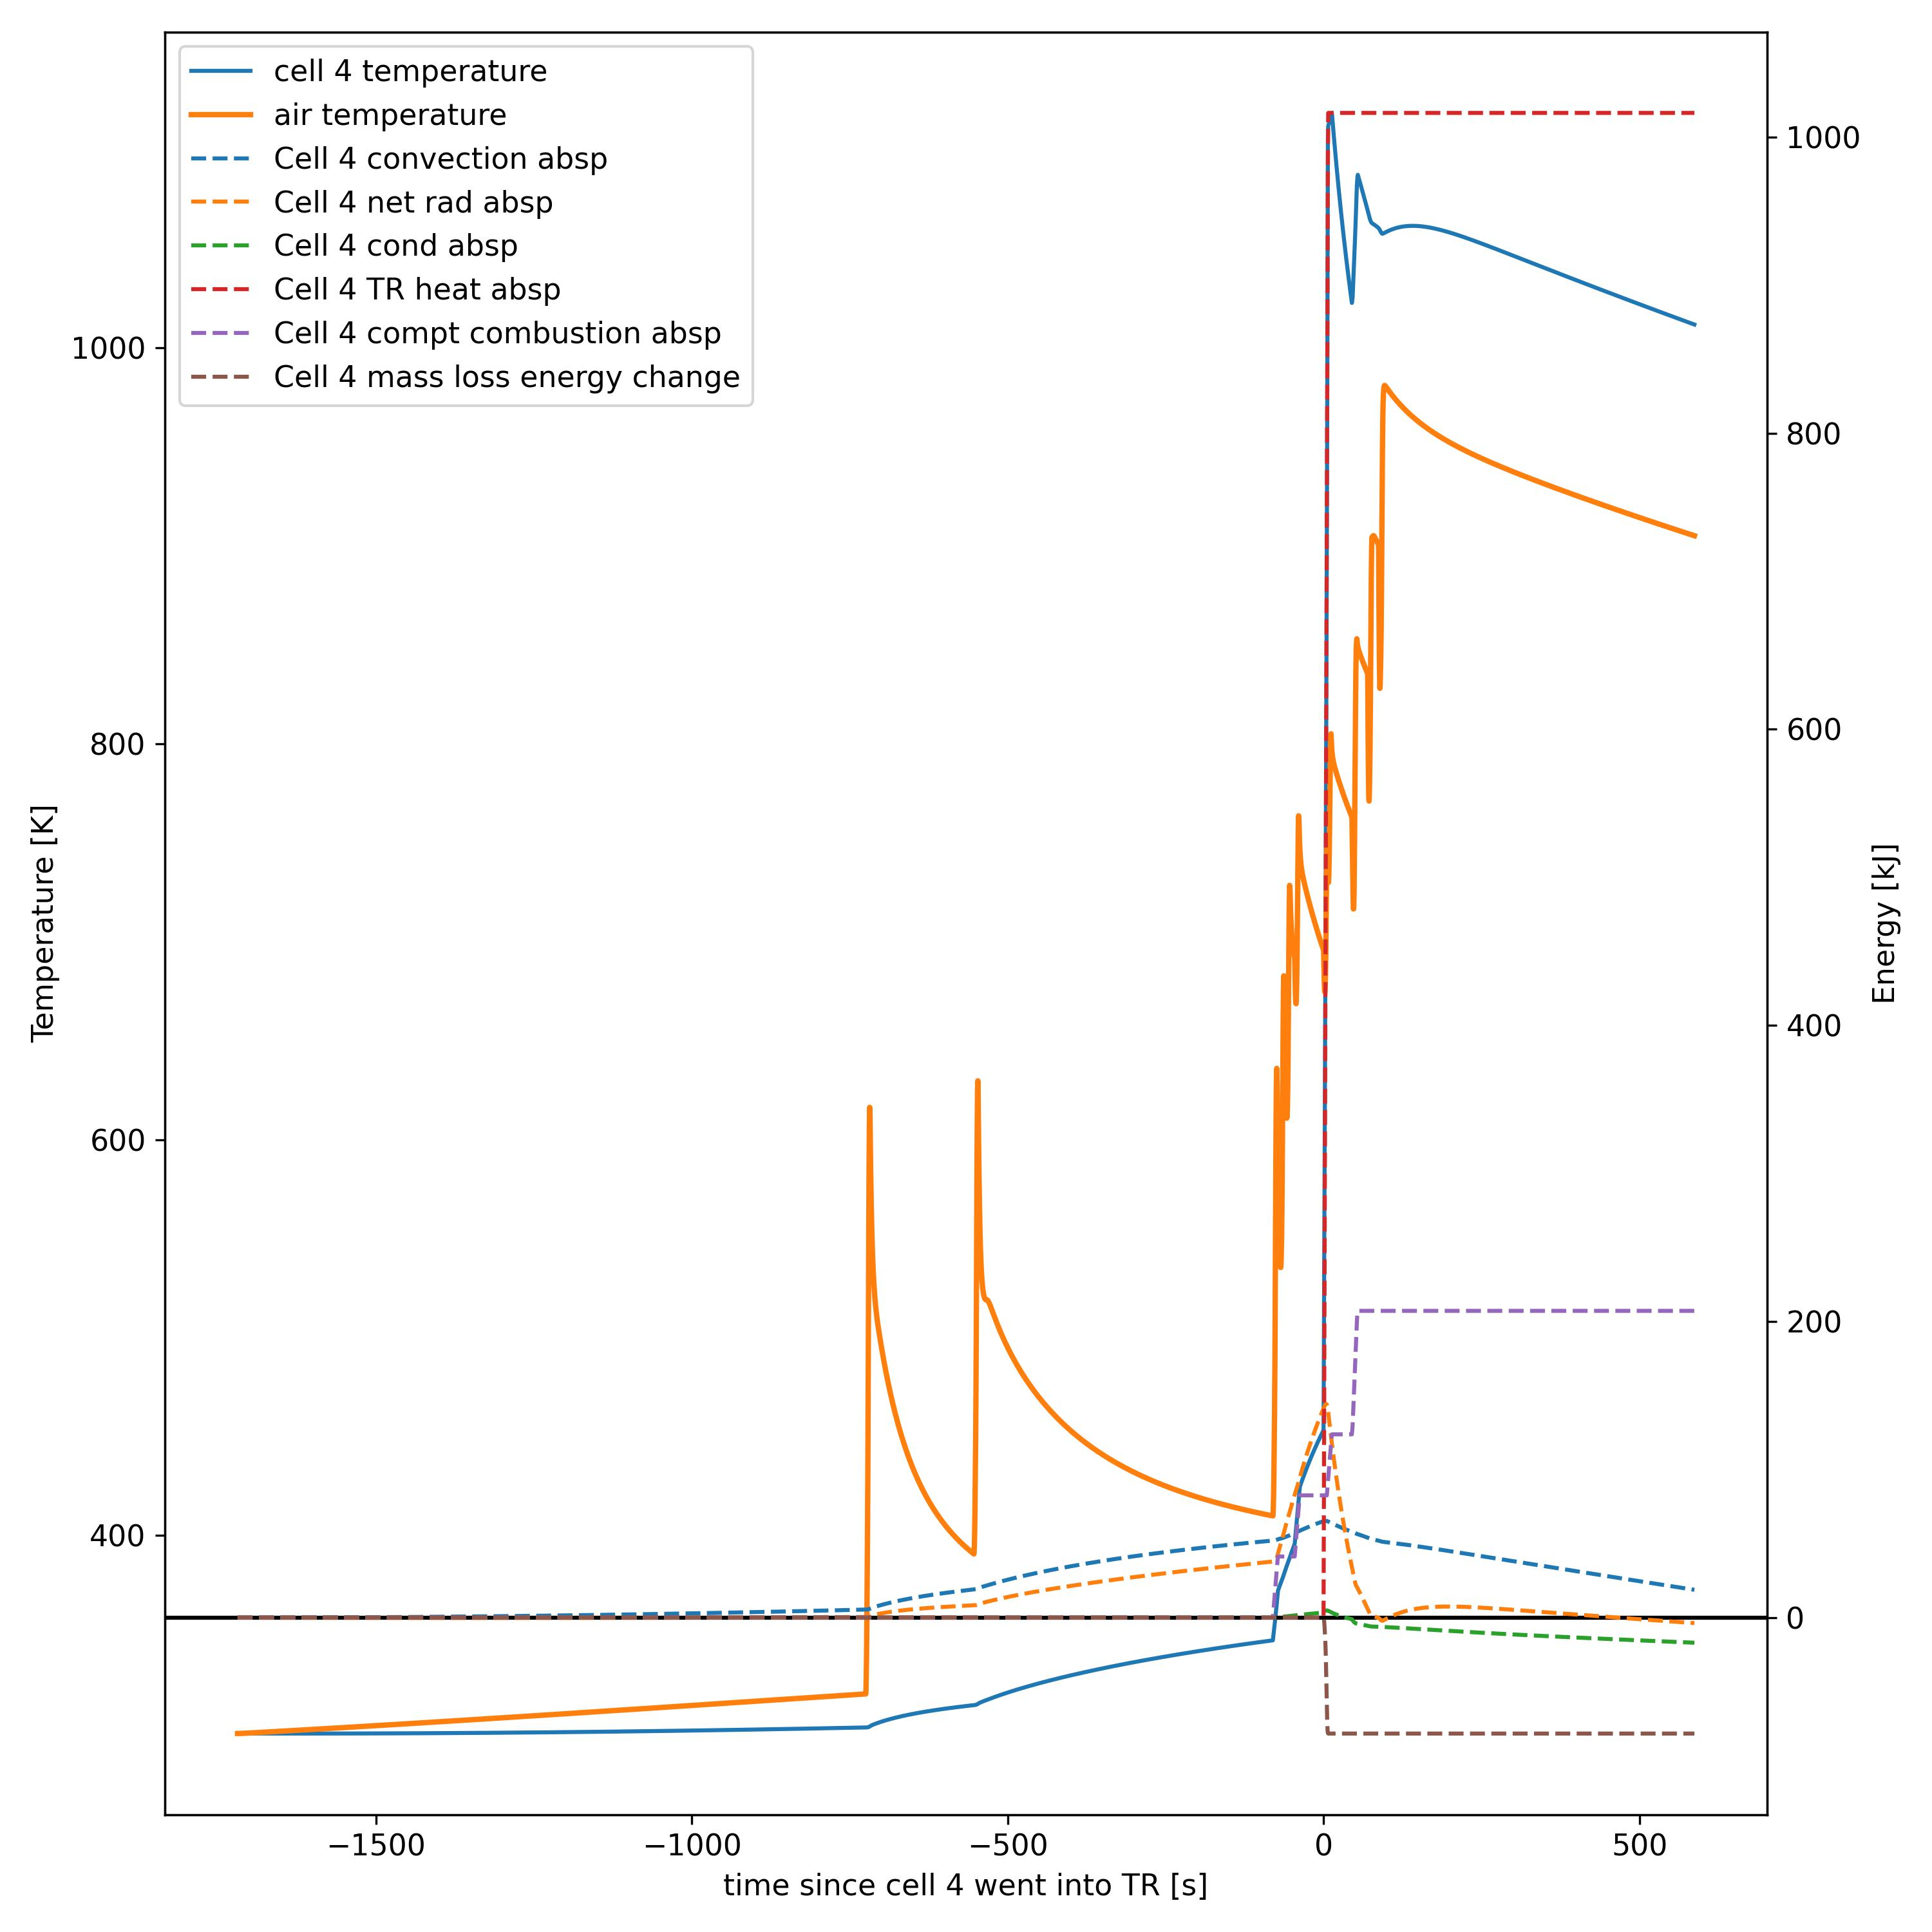
Preliminary Results
For cell 4, the compartment fire was also the main contributor of the fast temperature up climb and the sequential TR
The convection and radiation heat absorption did increase the cell 4 temperature during the preheating process. However, the compartment fire heating source drastically increased the cell temperature and brought it to thermal runaway.
Cell 4 energy budget graph

Slide 23
Preliminary Results

Slide 24
Improved model geometry and naming conventions
East
east-west spacing
north-south spacing
1
2
7
North
east-west gap
South
8
14
north-south gap
West

